Slide 1
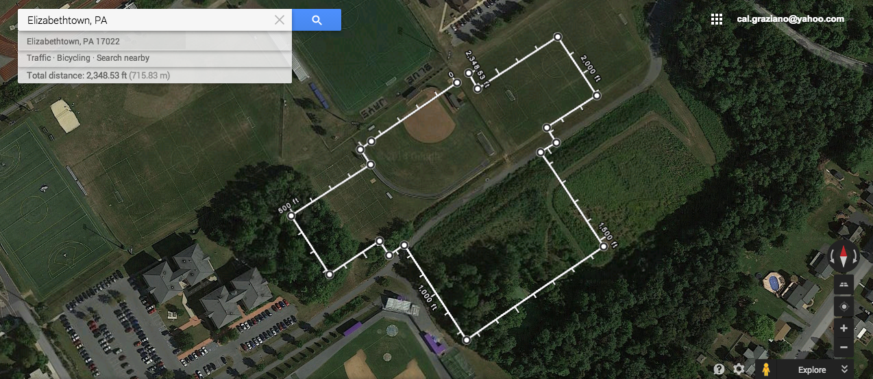
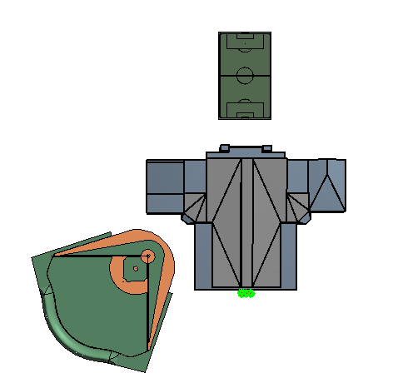
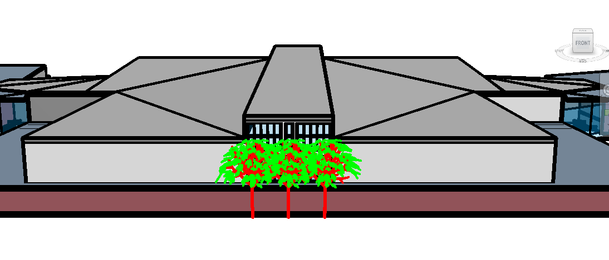
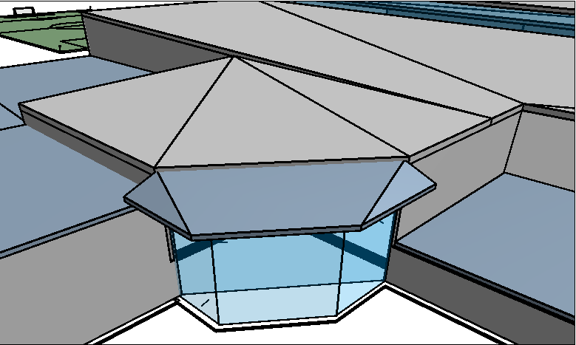
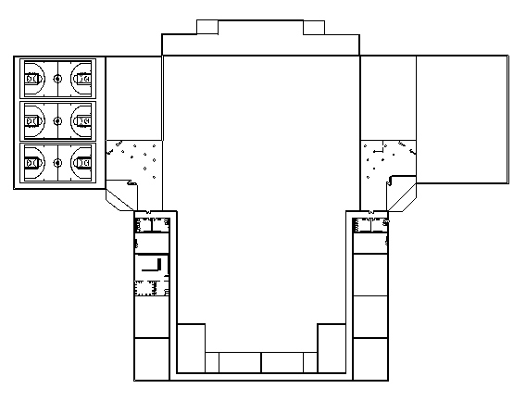
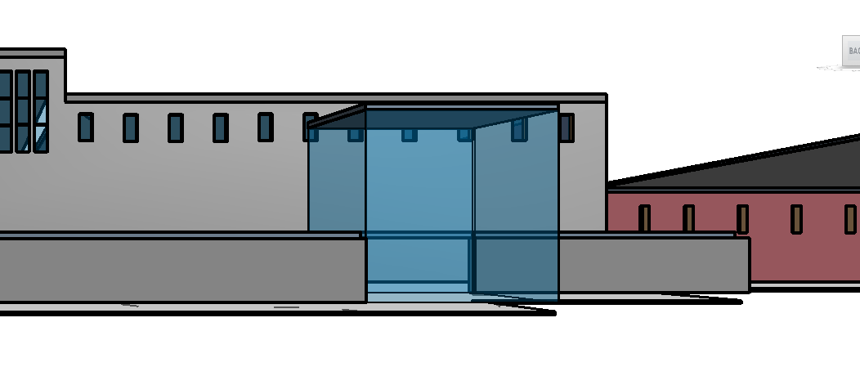
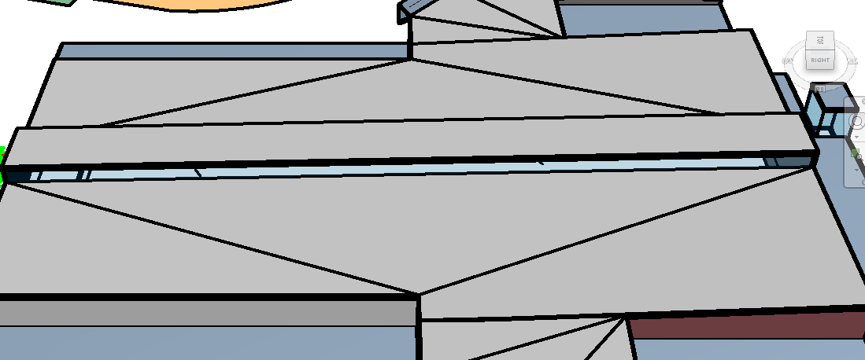
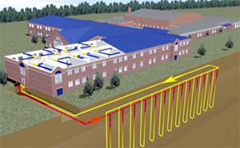
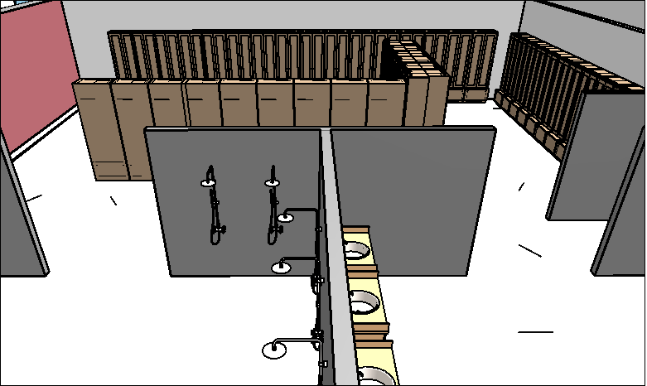
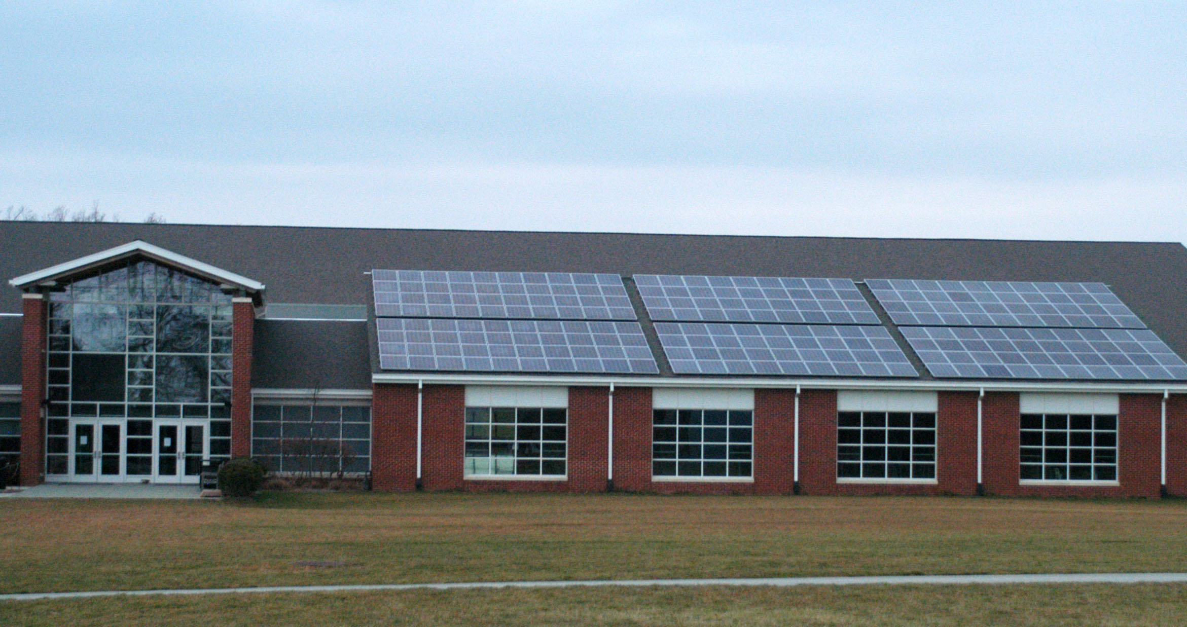
Wellness Center Design Proposal
Elizabethtown College
Brynne Kirsch, Cal Graziano, Sarah Fay
EGR 343: Green Architectural Engineering
LEED HIGHLIGHTS
NCCA8 locker rooms
Regulation track
Trainer’s room
Equipment room
Laundry loop room
Weight room
A multipurpose room
3 Offices
Large lobbies, social space
A turf room
6 Bathrooms
Counseling rooms
A multipurpose room
Spacious walkway/overlook
2 Cafes

